Slide 1
Chapter 18: Exploratory factor analysis

Slide 2
Aims
Explore Factor Analysis and Principal Component Analysis (PCA)
What Are Factors?
Representing Factors
Graphs and Equations
Extracting factors
Methods and Criteria
Interpreting Factor Structures
Factor Rotation
Reliability
Cronbach’s alpha

Slide 3
What is Factor Analysis?
A technique that identify groups or clusters of variables.
Reducing many variables to fewer variables
When to use factor analysis:
Not able to measure the construct (latent variable) directly but measure different aspects of the construct.
Use FA to show if these different variables are driven by the same underlying variable

Slide 4
When and Why?
To test for clusters of variables or measures.
To understand the structure of a set of variable
What is the structure of intelligence?
To construct a questionnaire to measure an underlying variable
How do you design a questionnaire to measure ‘love’?
To reduce a data set to a more manageable size while retaining as much of the original information as possible
To see whether different measures are tapping aspects of a common dimension.
E.g. Anal-Retentiveness, Number of friends, and social skills might be aspects of the common dimension of ‘statistical ability’

Slide 5
When and Why?
To see whether different measures are tapping aspects of a common dimension.
E.g. Anal-Retentiveness, Number of friends, and social skills might be aspects of the common dimension of ‘statistical ability’

Slide 6
Factors and components
Factor analysis attempts to achieve parsimony by explaining the maximum amount of common variance in a correlation matrix using the smallest number of explanatory constructs.
These ‘explanatory constructs’ are called factors.
PCA tries to explain the maximum amount of total variance in a correlation matrix.
It does this by transforming the original variables into a set of linear components.

Slide 7
R-Matrix
In Factor Analysis and PCA we look to reduce the R-matrix into smaller set of uncorrelated dimensions.

Slide 8
Graphical representation
Factors are identified by looking for variables that correlate highly with a group of other variables but do not correlate with variables not in the group.
The coordinate of a variable along a classification is known a factor loading. A Pearson correlation between a factor and a variable.
Notes:
For both factor the axis range from -1 to +1. the position a variable is on depends on its correlation coefficient. Grouped together higher correlation; apart a different factor. Diagram shows 2 factors sociability and consideration.

Slide 9

Mathematical representation: components
$$Y_{i}=b_{1}X_{1i}+b_{2}X_{2i}+⋯+b_{n}X_{ni}$$
$${Component}_{i}=b_{1}{Variable}_{1i}+b_{2}{Variable}_{2i}+⋯+b_{n}{Variable}_{ni}$$
b = factor loading
$${\text{Sociability}}_{i}=b_{1}{\text{Talk}\text{ (}\text{other}\text{)}}_{i}+b_{2}{\text{Social} \text{Skills}}_{i}+b_{3}{\text{Interest}}_{i}{+ b}_{4}{\text{Talk} \text{(}\text{self}\text{)}}_{i}+b_{5}{\text{Selfish}}_{i}+b_{6}{\text{Liar}}_{i}$$
$${\text{inconsideration}}_{i}=b_{1}{\text{Talk}\text{ (}\text{other}\text{)}}_{i}+b_{2}{\text{Social} \text{Skills}}_{i}+b_{3}{\text{Interest}}_{i}{+ b}_{4}{\text{Talk} \text{(}\text{self}\text{)}}_{i}+b_{5}{\text{Selfish}}_{i}+b_{6}{\text{Liar}}_{i}$$
Notes:
Replace b with those value from the factor plot. When b values are very low (close to 0), this means the factor is not very important.

Slide 10
Mathematical representation: factors
The factors in Factor Analysis are not represented in the same way as components.
Variables = Variable Means + (Loadings × Common Factor) + Unique Factor

Slide 11

Factor Loadings
Both factor analysis and PCA are linear models in which loadings are used as weights.
These loadings can be expressed as a matrix
This matrix is called the factor matrix or component matrix (if doing PCA).
The assumption of factor analysis (but not PCA) is that these algebraic factors represent real-world dimensions.
$$Λ=\left(\begin{matrix}0.87 & 0.01 \\ 0.96 & −0.03 \\ 0.92 & 0.04 \\ 0.00 & 0.82 \\ −0.10 & 0.75 \\ 0.09 & 0.70\end{matrix}\right)$$

Slide 12
Factor Scores
A factor can be described in terms of the variables measured & the relative importance of them for the factor
Regression method is used to calculate factor scores where factor loadings are adjusted to take account of the initial correlations between variables (p.785-787). (other methods: Barlett and Anderson-Rubin)
Uses of factor scores
Reduce a large set of data to a smaller subset of measurement variables
Overcoming collinearity problems in regression – combining those with multicollinearity in to a single factor

Slide 13
Discovering Factors
There are many methods to discovering methods:
Exploring data (PCA, PFA, ICA) or testing hypothesis (i.e. structural, CFA)
Communality – the proportion of common variance (shared) present in a variable
Variable no specific variance – 1
Variable shared no variance - 0
In FA we are interested to find common underlying dimensions within the data
Notes:
Exploring data to generate future hypotheses.

Slide 14
Discovering Factors
FA
Derives a mathematical model from which factors are estimated
Only FA can estimate the underlying factors
PCA
Decomposes the original data into a set of linear variates
Concern only with establishing which linear component exist within the data
How a particular might contribute to the component
Notes:
Two approaches to find underlying dimensions of a data set.
Differ in the communality estimates that are used

Slide 15
Theory behind PCA
Like MANOVA & DFA
Uses correlation matrices – look at whether groups could be separated by some linear combination of the DVs by calculating the eigenvectors of the SSPC
Retain factors with the largest eigenvalues and ignore the small eigenvalues

Slide 16
Factor Extraction: Eigenvalues & Scree Plots
How do we know which eigenvalues are large enough to be a meaningful factor?
Plot eigenvalue against the factor – scree plot
Cut-off point for selecting factors – point of inflexion of the curve (where the slope of the line changes dramatically
Retain/extract only factors to the left of the point of inflexion (do not include the factor at point of inflexion) – use if sample size more than 200
retaining all eigenvalues > 1 (Kaiser’s criterion) – SPSS uses this.
In combination look at commonalities of factors (choose those close to 1)

Slide 17
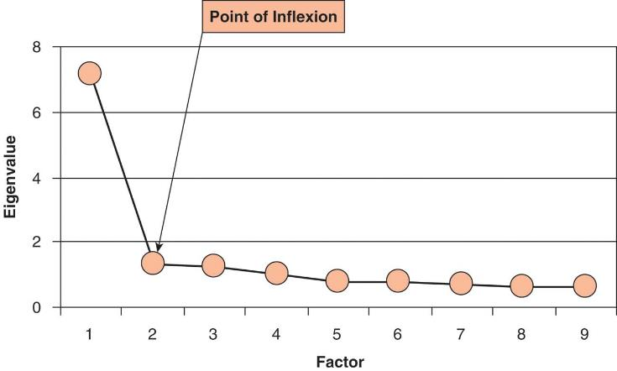

Slide 18
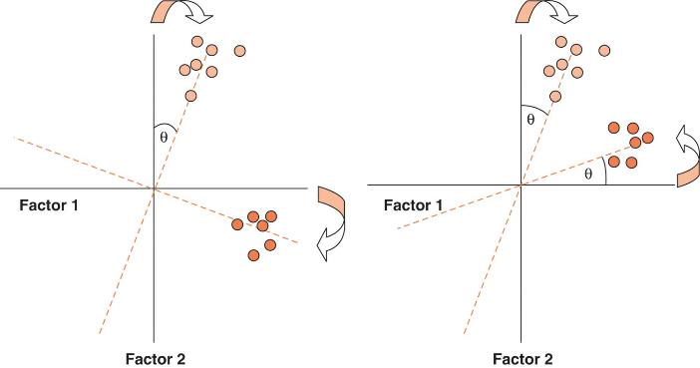
Factor rotation
Use to discriminate between factors – variables are maximally loaded to only one factor.
Orthogonal
Oblique
Notes:
Orthogonal – unrelated. Factors are kept independent (uncorrelated)
Oblique – factors are allowed to correlate.
Which you choose depends on theoretical reasons.

Slide 19
Method of factor rotation
Orthogonal - unrelated. Factors are kept independent (uncorrelated)
Varimax – maximize the dispersion of loadings within factors. Load a smaller number of variables highly onto each factor resulting in more interpretable clusters of factors.
Quartimax – maximize the spread of factor loading for a variable across all factors
Equamax – hybrid of the two
Oblique - factors are allowed to correlate.
Direct oblimin – degree of allowed correlation is determined by delta (a constant value)
Promax – faster procedure for large data sets

Slide 20
Factor loadings
Typical > |0.3|
Stevens (2000)
N=50 a loading of 0.722 can be considered significant
N=100 > 0.512
N=200 > 0.364
N=300 > 0.298
N=600 > 0.21
N=1000 >0.162
Squaring factor loading – amount of variance accounted for by a variable. > 0.4

Slide 21
An Example

Slide 22
The SAQ

Slide 23
The Process

Slide 24
1. Initial considerations: Sample Size
Sample size – how many?
10-15 participant per variable
See p. 797 (depends on factor loadings)
300 or more

Slide 25
1. Initial considerations: Correlations between Variables
The quality of analysis depends upon the quality of the data (GI⇒GO).
Test variables should correlate quite well
r > 0.3
Avoid Multicollinearity:
several variables highly correlated, r > 0.80
Avoid Singularity:
some variables perfectly correlated, r = 1.
Screen the correlation matrix, eliminate any variables that obviously cause concern
Notes:
Correlations between variables
Problem: too low (<.3) or too high (>.8)
Barlett’s test – testing if correlation matric is significantly different from identity matrix- want this to be significant

Slide 26
1. Initial considerations: Distribution of Data
The distribution of data – assumption of normality important for generalization

Slide 27
Factor Analysis on SPSS
SAQ.sav
Preliminary Analysis
Factor extraction
Factor Rotation
Factor Scores
Options

Slide 28
Further considerations
Determinant:
Indicator of multicollinearity
should be greater than 0.00001
Kaiser-Meyer-Olkin (KMO):
Measures sampling adequacy
should be greater than 0.5
Bartlett’s Test of Sphericity
Tests whether the R-matrix is an identity matrix
should be significant at p < 0.05
Anti-Image Matrix
Measures of sampling adequacy on diagonal
Off-diagonal elements should be small
Reproduced
Correlation matrix after rotation
Most residuals should be < |0.05|

Slide 29
2a. Factor Extraction Finding factors: Communality
Common variance:
Variance that a variable shares with other variables.
Unique variance:
Variance that is unique to a particular variable.
The proportion of common variance in a variable is called the communality
Communality = 1, All variance shared.
Communality = 0, No variance shared.
0 < Communality < 1 = Some variance shared.

Slide 30
Communality = 1
Variance of
Variable 3
Variance of
Variable 1
Variance of
Variable 2
Communality = 0
Variance of
Variable 4

Slide 31
Finding factors
We find factors by calculating the amount of common variance
Circularity
Principal components analysis:
Assume all variance is shared
All Communalities = 1
Factor Analysis
Estimate Communality
Use squared multiple correlation (SMC)

Slide 32
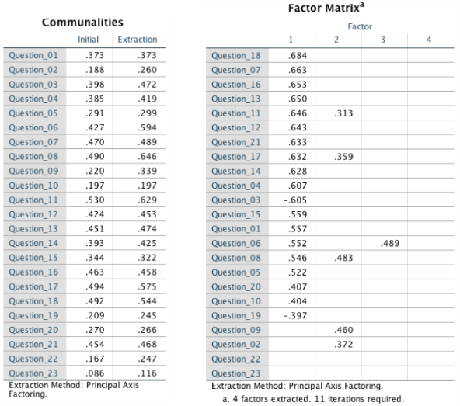

Slide 33
2a. Factor Extraction
Kaiser’s extraction
Kaiser (1960): retain factors with eigen values > 1
Scree plot
Cattell (1966): use ‘point of inflexion’ of the scree plot
Which rule?
Use kaiser’s extraction when
Less than 30 variables, communalities after extraction > 0.7
Sample size > 250 and mean communality ≥ 0.6
Scree plot is good if sample size is > 200

Slide 34
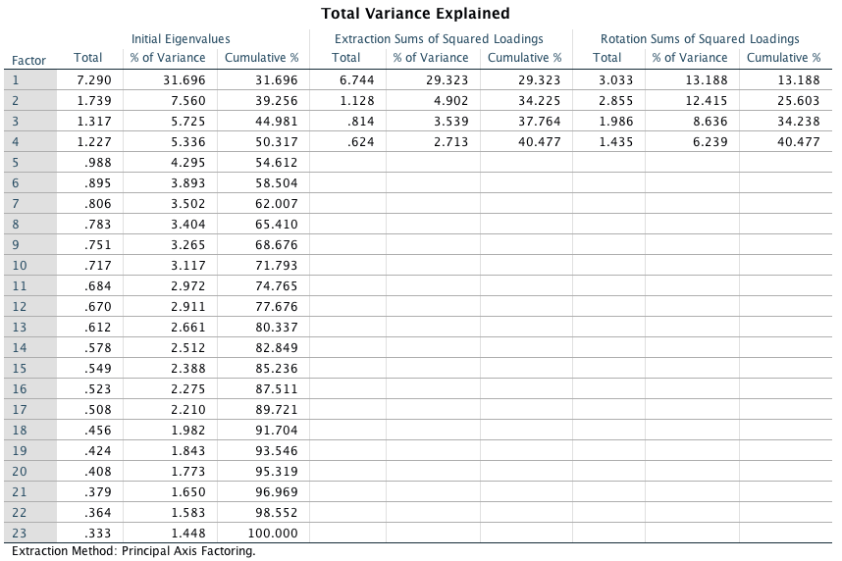

Slide 35
The scree plot

Slide 36
2b. Rotation
To aid interpretation it is possible to maximise the loading of a variable on one factor while minimising its loading on all other factors
This is known as Factor Rotation
There are two types:
Orthogonal (factors are uncorrelated)
Oblique (factors correlate)

Slide 37
Orthogonal
Oblique

Slide 38
Before rotation

Slide 39
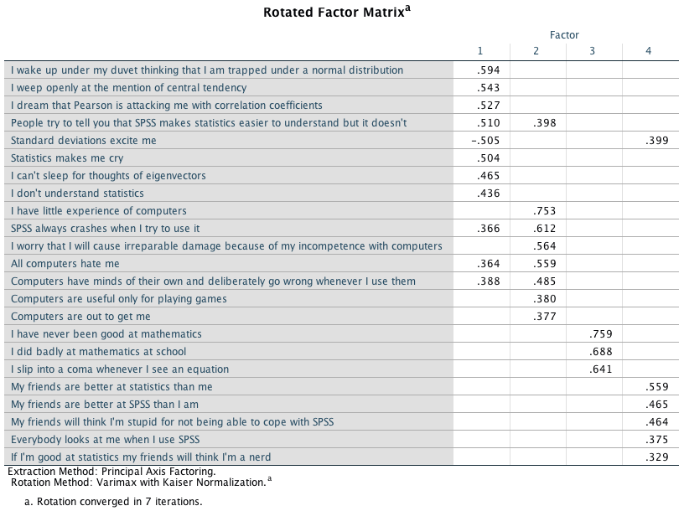
Orthogonal rotation (varimax)

Slide 40
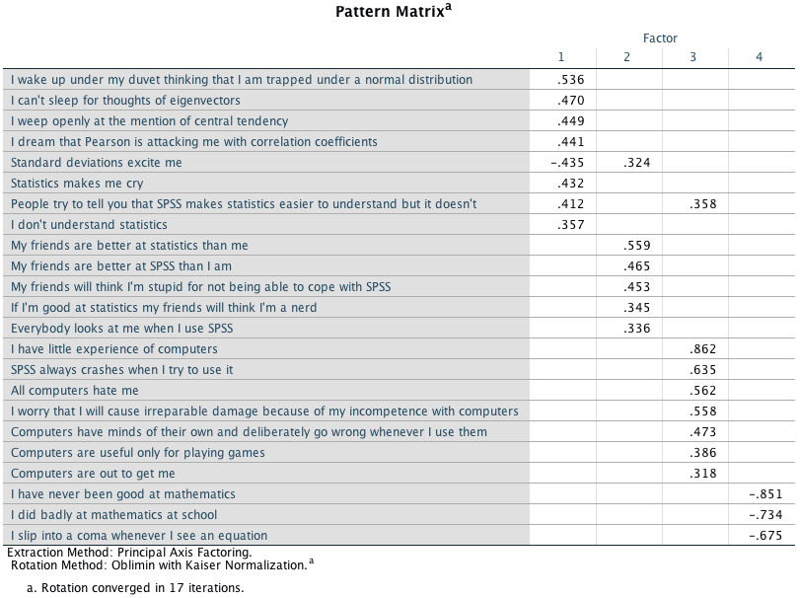
Oblique rotation

Slide 41
3. Reliability
Test-Retest Method
What about practice effects/mood states?
Alternate Form Method
Expensive and Impractical
Split-Half Method
Splits the questionnaire into two random halves, calculates scores and correlates them.
Cronbach’s Alpha
Splits the questionnaire into all possible halves, calculates the scores, correlates them and averages the correlation for all splits (well, sort of …).
Ranges from 0 (no reliability) to 1 (complete reliability)

Slide 42
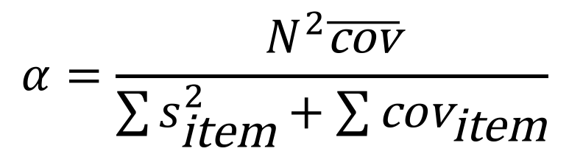
Cronbach’s alpha
$$α=\frac{N^{2}\overline{\text{cov}}}{\sum{s_{\text{item}}^{2}}+\sum{{\text{cov}}_{\text{item}}}}$$

Slide 43
Interpreting Cronbach’s alpha
Kline (1999)
Reliable if α > 0.7
Depends on the number of items
More questions = bigger α
Treat Subscales separately
Remember to reverse score reverse phrased items!
If not, α is reduced and can even be negative

Slide 44
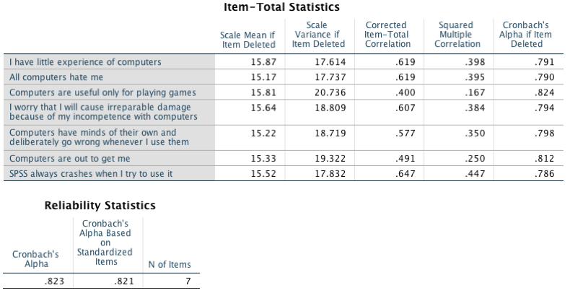
Reliability for fear of computers subscale

Slide 45
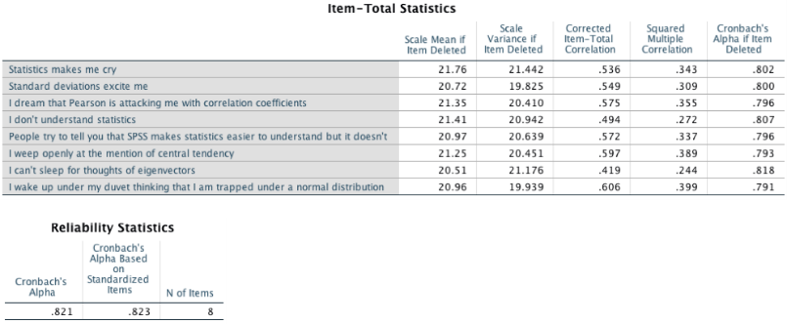
Reliability for fear of statistics subscale

Slide 46
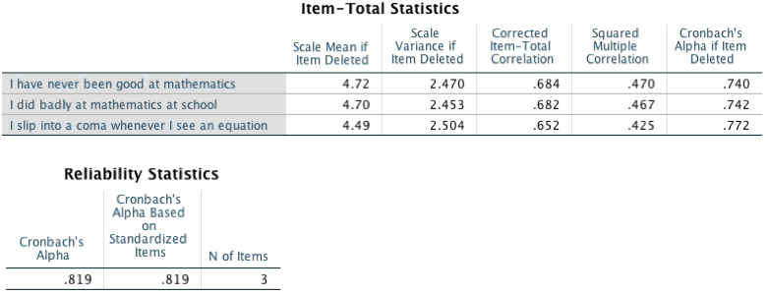
Reliability for fear of maths subscale

Slide 47
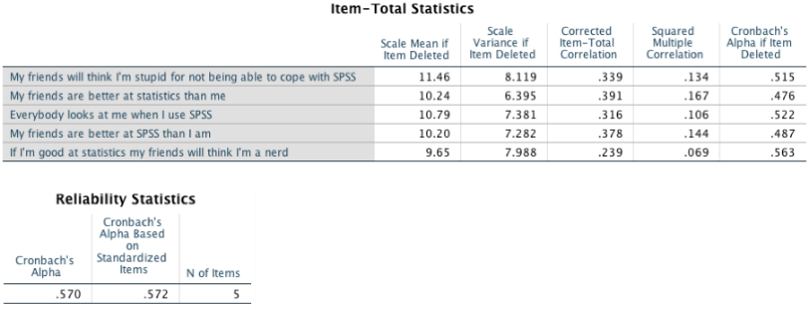
Reliability for the peer evaluation subscale

Slide 48
The end?
Describe Factor Structure/Reliability
What items should be retained?
What items did you eliminate and why?
Application
Where will your questionnaire be used?
How does it fit in with psychological theory?

Slide 49
The End

